Slide 1
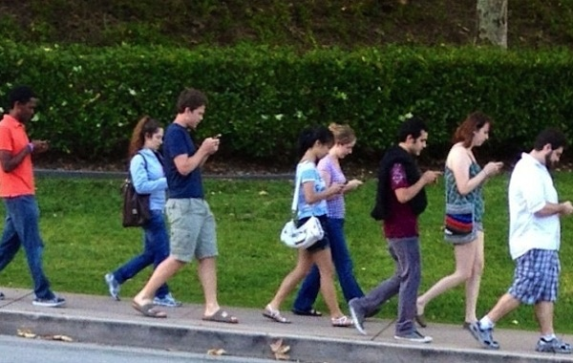
THE FUTURE OF HUMAN CONNECTION: What therapists should know about sex, lies, love, and relating on the Internet - and some key skill
Psi.D Robert Allegri dr.allegri@miopsicologo.it FB:Miopsicologo Robert Allegri
Psi.D. Katia Manduchi kmanduchi@hotmail.com FB:Katia Manduchi
Ph.D Gareth Holman garethholman@gmail.com

Slide 2
Let’s start with us
Please raise your
hand if …

Slide 3
Someone uses …

Slide 4
Someone also uses …
“new technologies”
for / in therapy?

Slide 5
We all deal with technology…
and it effects our relationships!
do you know how much time your clients spend online
/ and or, what they do on Internet?

Slide 6
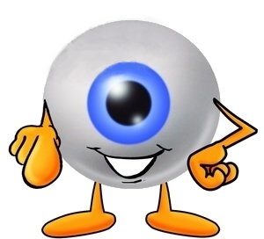
Different theraeutic
approaches
ACT – FAP – CBT – RFT …
or look at them from a functional perspective:
moving
away
going
towards

Slide 7
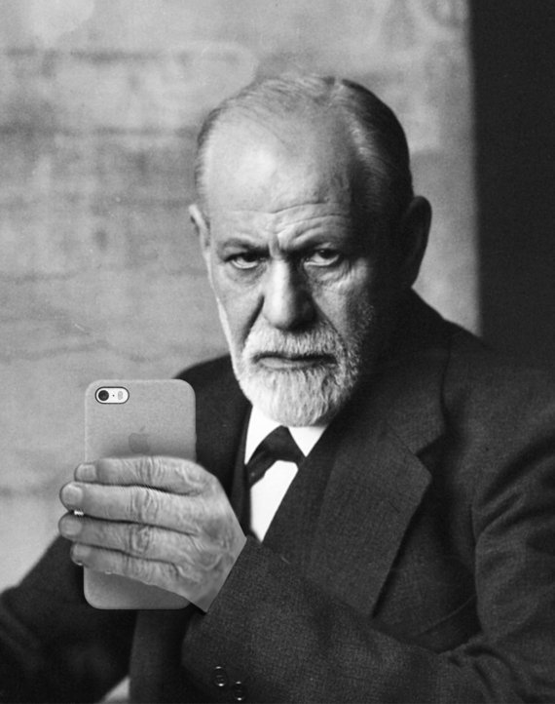
Sex - love- relationship
In the new era,
can we learn more about it?
Our experience as therapists with clients

Slide 8
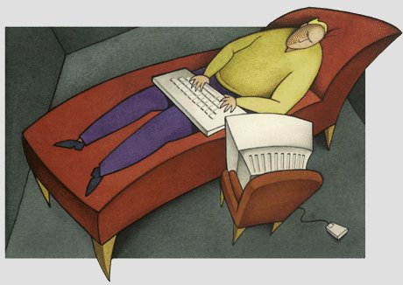
Exercise
Split in pairs
with your partner describe briefly your experience as therapist using new technologies

Slide 9
Assessing
What forms of online/virtual social connection do you use? How much time do you spend on each? Consider: social media sites, chat, online dating, text message, email, blog, Twitter, etc.
How do these means of connection work for you? Assess for positive and negative outcomes.
Do you present yourself differently in «virtual contexts» compared to face-to-face? Assess for differences from face-to-face interactions – efffective bx or ineffective bx. (E.g., Are you able to be more honest or more dishonest online? Or a mix of both?)
In your view, what are the best parts of virtual social connection? What are the worst parts?
Are there any forms of online/virtual social connection that you avoid or dislike? Why?

Slide 10
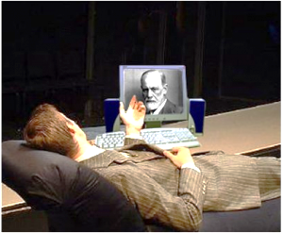
Exercise
Split in pairs
with your partner try to figure out a difficult situation occurring between you and one of your client that involved new technology
Identify a more functional behavior
you might use in the future

Slide 11
Thank you for the attention
Psi.D Robert Allegri dr.allegri@miopsicologo.it FB:Miopsicologo Robert Allegri
Psi.D. Katia Manduchi kmanduchi@hotmail.com FB:Katia Manduchi
Ph.D Gareth Holman garethholman@gmail.com

